Slide 1
CoCHI projects

Slide 2
Collaboration and computer-human interaction (CoCHI)
Human-Computer Interaction research
We understand computers as mediators of human activity
We develop new interaction techniques, methods and theories for computer-mediated activities of work and everyday life

Slide 3

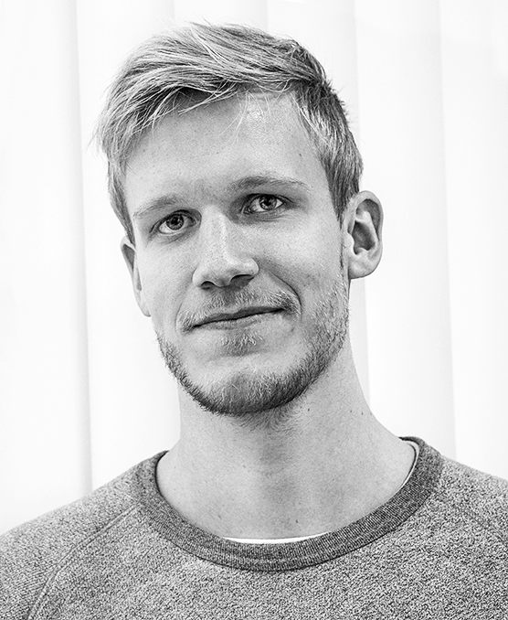


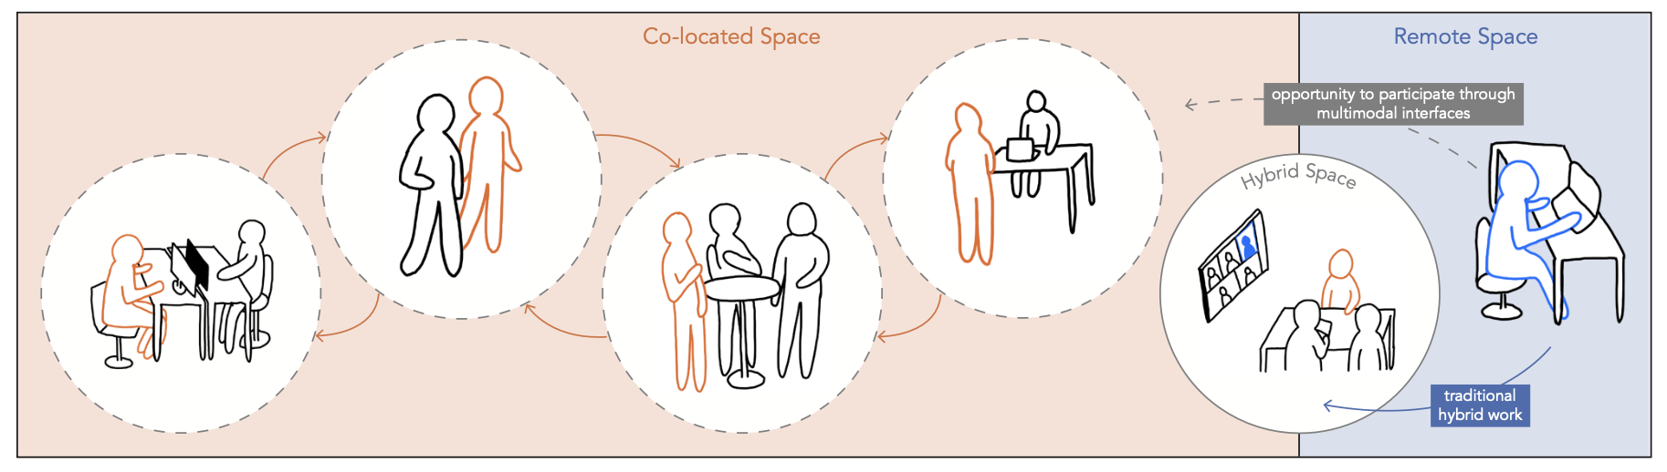
Hybrid Work
Exploring Multimodal Backchannel Communication in Hybrid Meetings
Multimodal Physical Computing Interfaces for Mobile Hybrid Meetings
Hybrid Meetings (lightweight interactions and multimodality)
Primary Room Dominance

Slide 4
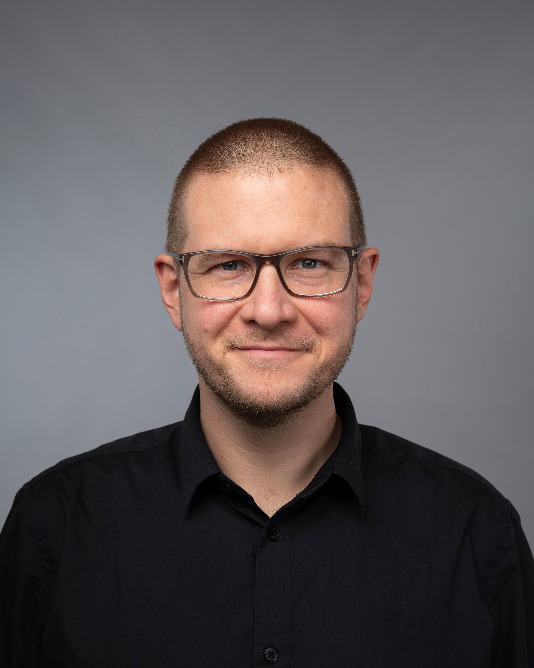
LLMs in computational notebooks
Computational notebooks such as Jupyter Notebook or Observable have become popular tools in for data processing or visualisation.
In this project, the students will explore different techniques for integrating interaction
with an LLM directly into a notebook interface.
The ideation and prototyping will involve working with scientific users of computational notebooks. Hence, the bachelor project will require engaging in user-centred design as well as technical implementation of functional prototypes.

Slide 5
Violations of personal digital sovereignty
Personal digital sovereignty consists of an individual’s independence, autonomy, and control in their relationship with data, software, and hardware:
In this project, the students will pick a profession (electronic musicians, patent clerks, communication consultants, architects, teachers, medical doctors...) and document when the participants' personal digital sovereignty is violated and what aspects of the software are a cause of this.

Slide 6
Physical and multimodal computing
Vibrotactile Feedback for Mobile Text Entry
run an experiment to compare devices with a physical keyboard, a basic touchscreen and a touchscreen with tactile feedback added.
Unique Features = Unique Products
develop scripted 3D model generation of computer peripherals ergonomically and custom designed for unique features
Exploring minimal social cues in artefact-inspired robots
(Majken Kirkegård Rasmussen mkirkegaard@cc.au.dk)
The Future of Physical Computing
didactically designing and user testing new learning designs and methods focusing on newer microcontrollers and surrounding technologies

Slide 7
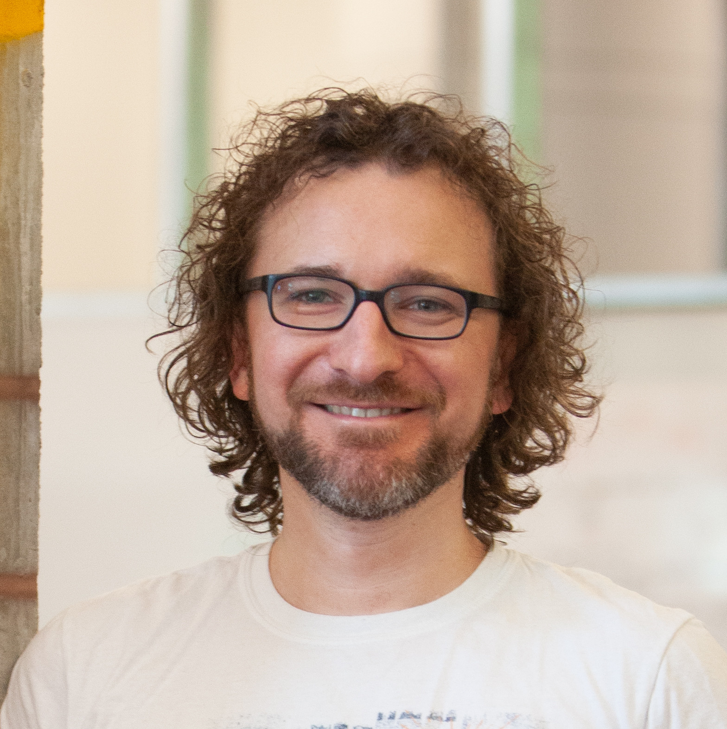


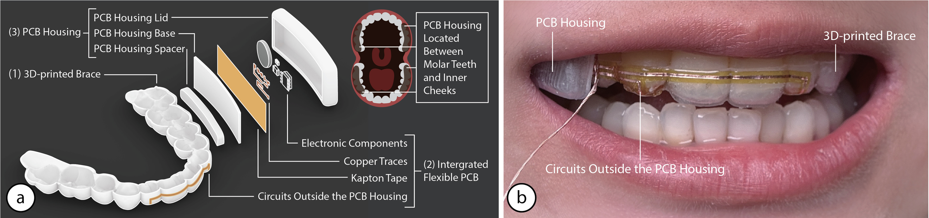
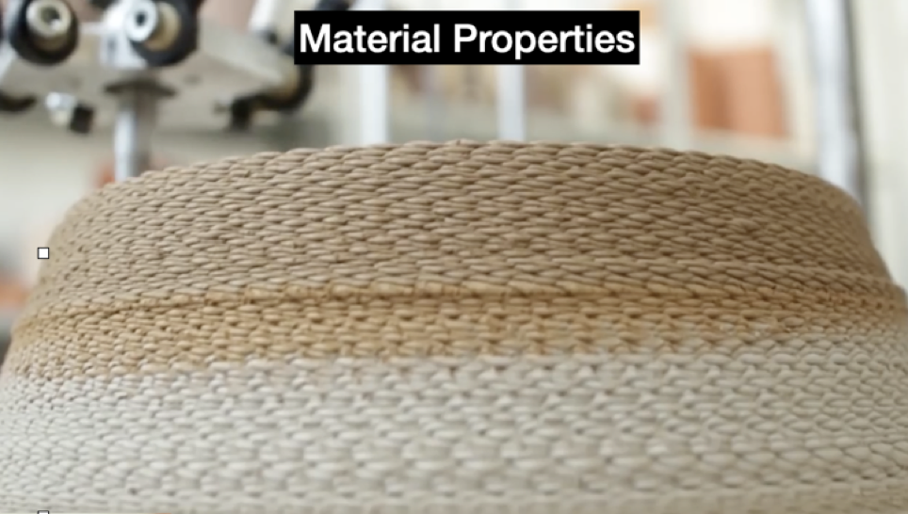
fabrication
AI-Driven Design and Manufacturing: Leveraging LLMs for CAD, Slicing, and 3D Printing Automation
Interaction and Sensing with Oral User Interfaces
Haptic textures in 3D printing

Slide 8
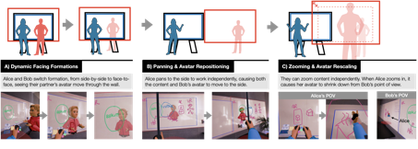
Mixed reality
How can Mixed Reality blend different spaces for collaboration?
Mixed Reality Whiteboard Collaboration
Tracking paper with computer vision for Dynamicland-inspired ‘reverse augmented reality’

Slide 9
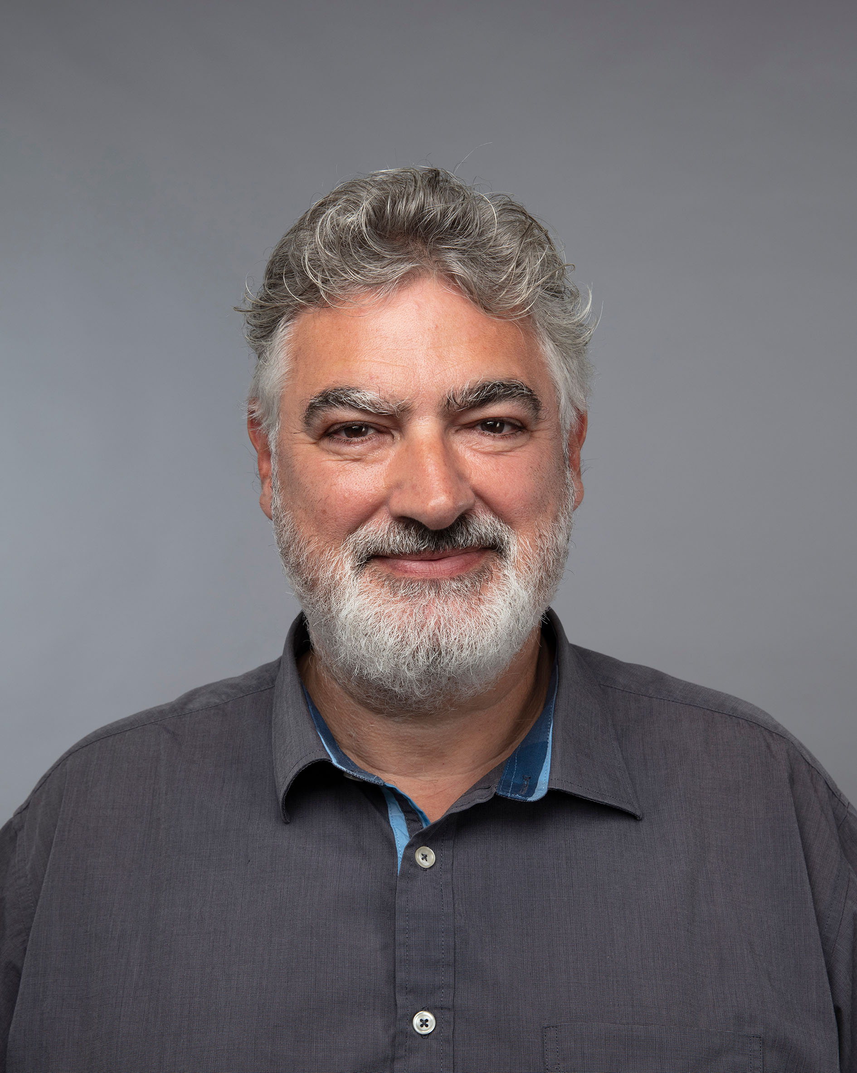
A Case study of an IT development project in an organization
Students will conduct a systematic case study of an IT-development project in an
organisation or company.
The purpose of this is twofold
to learn something about systems development and about the specific project
to learn to conduct a qualitative study in an organisational setting.

